Slide 1

Sugar Cosmetics Instagram Performance Dashboard
By Rupali Jain

Slide 2
Agenda
Introduction & Objective
My Role & Responsibilities
Dataset Overview
Tools & Techniques
Complete Dashboard Overview
Sheet-by-Sheet Walkthrough
Process Followed
Key Insights & Business Impact
Conclusion

Slide 3
Project Objective
Analyze Sugar Cosmetics’ Instagram performance to understand audience engagement.
Identify best-performing post types, hashtags, and posting days.
Discover trends to improve reach and interaction.
Present findings through an interactive Tableau dashboard.

Slide 4
My Role & Responsibilities
Cleaned and standardized Instagram dataset in Excel.
Created calculated fields — Engagement Rate and Post Label.
Built Tableau dashboard with filters and KPIs.
Designed visuals: Top Posts, Post Type Performance, Hashtag Analysis, Funnel.
Prepared insights report and project video.

Slide 5
Dataset Overview
Source: Provided by LabMentix.
Size: ~350 posts with engagement metrics.
Columns: Post-Date, Post-Type, Likes, Comments, Shares, Saves, Reach, Impressions, Hashtags.
Derived fields:
Engagement Rate = (Likes + Comments + Shares + Saves) / Reach
Post-Label = Post-Date + Post-Type

Slide 6
Tools & Techniques
Excel — Data cleaning & helper columns.
Tableau — Dashboard creation & analysis.
Techniques — Filters, Top N filters, Calculated Fields, Tooltips.
Theme — Sugar pink color palette and minimal design.

Slide 7
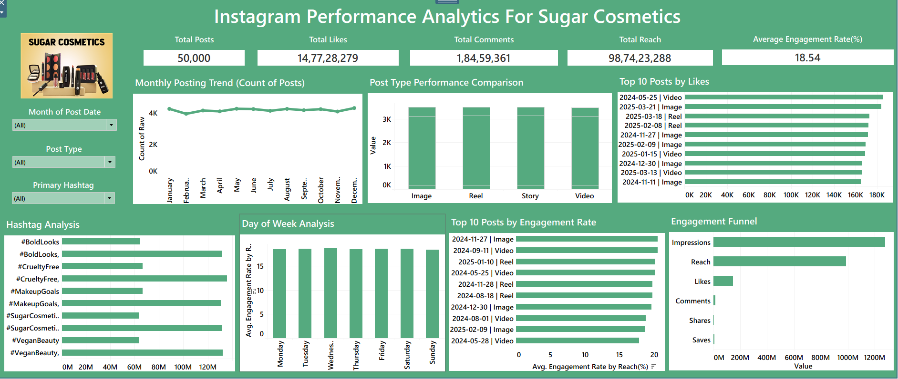
Complete Dashboard Overview
Interactive Tableau Dashboard showing KPIs, Trends, and Engagement Insights

Slide 8
Sheet 1 : KPI Overview
Shows Total Posts, Total Likes, Total Comments, Total Reach, Avg Engagement Rate.
Snapshot of overall Instagram performance.

Slide 9
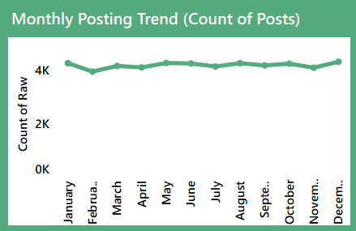
Sheet 2: Monthly Posting Trend
Line chart showing posts per month.
Reveals posting frequency and campaign spikes.
Helps identify seasonal engagement trends.

Slide 10
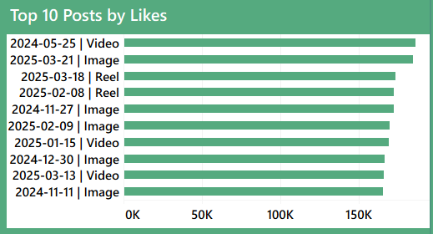
Sheet 3: Top 10 Posts by Likes
Bar chart ranking top 10 posts by Likes (using Post-Label).
Tooltips show Post-Date, Post-Type, Likes, Comments, Reach.
Highlights content that resonated most.

Slide 11
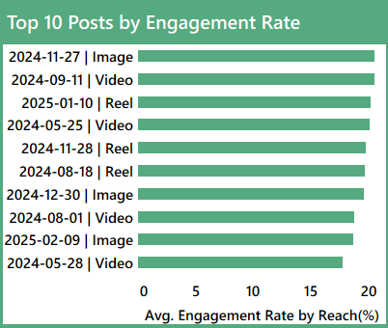
Sheet 4: Top 10 Post by Engagement Rate
Displays top 10 posts with highest Engagement %.
Measures depth of audience connection.

Slide 12
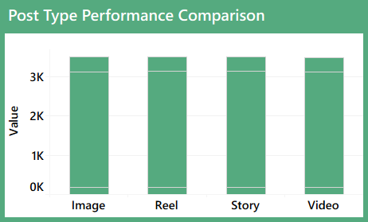
Sheet 5: Post Type Performance
Compares average Likes, Comments, Saves across Photos, Reels, Story and Videos.
Reels and Videos show top engagement.

Slide 13
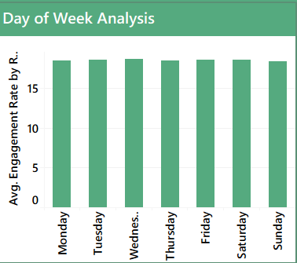
Sheet 6: Day of Week Analysis
Engagement Rate by weekday.
Wednesday and Saturday perform best.
Helps plan posting schedules.

Slide 14
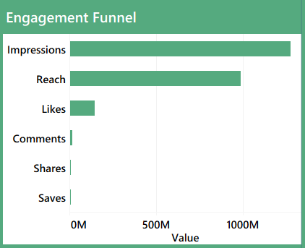
Sheet 7: Engagement Funnel
Impressions → Reach → Likes → Comments → Shares
Shows audience drop-offs and conversion points.

Slide 15
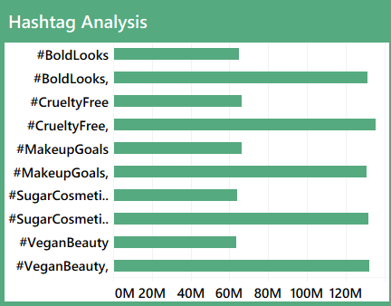
Sheet 8: Hashtag Analysis
Ranks hashtags by Engagement & Reach.
Identifies top-performing hashtags (#sugarcosmetics, #makeuplove).
Guides future hashtag strategy.

Slide 16
Process Followed
Cleaned data in Excel (removed duplicates, standardized).
Added calculated fields (Engagement Rate, Post-Label).
Connected Excel to Tableau.
Created visuals (KPI → Hashtag).
Finalized dashboard & insights report.

Slide 17
Key Insights
Reels and short video posts gained the highest Likes and Comments.
Engagement rate is noticeably higher during mid-week.
Posts using brand and trending hashtags like #sugarcosmetics and #makeuplove achieved wider reach and better visibility.
Content that was saved or shared more often reflects genuine audience interest.

Slide 18
Business Impact
Identified optimal posting schedule and content types.
Informed data-driven hashtag strategy.
Boosted awareness of engagement KPIs for marketing team.

Slide 19
Conclusion
Dashboard enables data-backed marketing strategy.
Future: Add sentiment analysis, reach forecasting.
Continue monthly tracking for improvement

Slide 20
Thank You
Connect on LinkedIn for more projects and dashboards.
www.linkedin.com/in/rupali-jain04

